Slide 1

Think of…10 things neighbours do that annoy you.

Slide 2
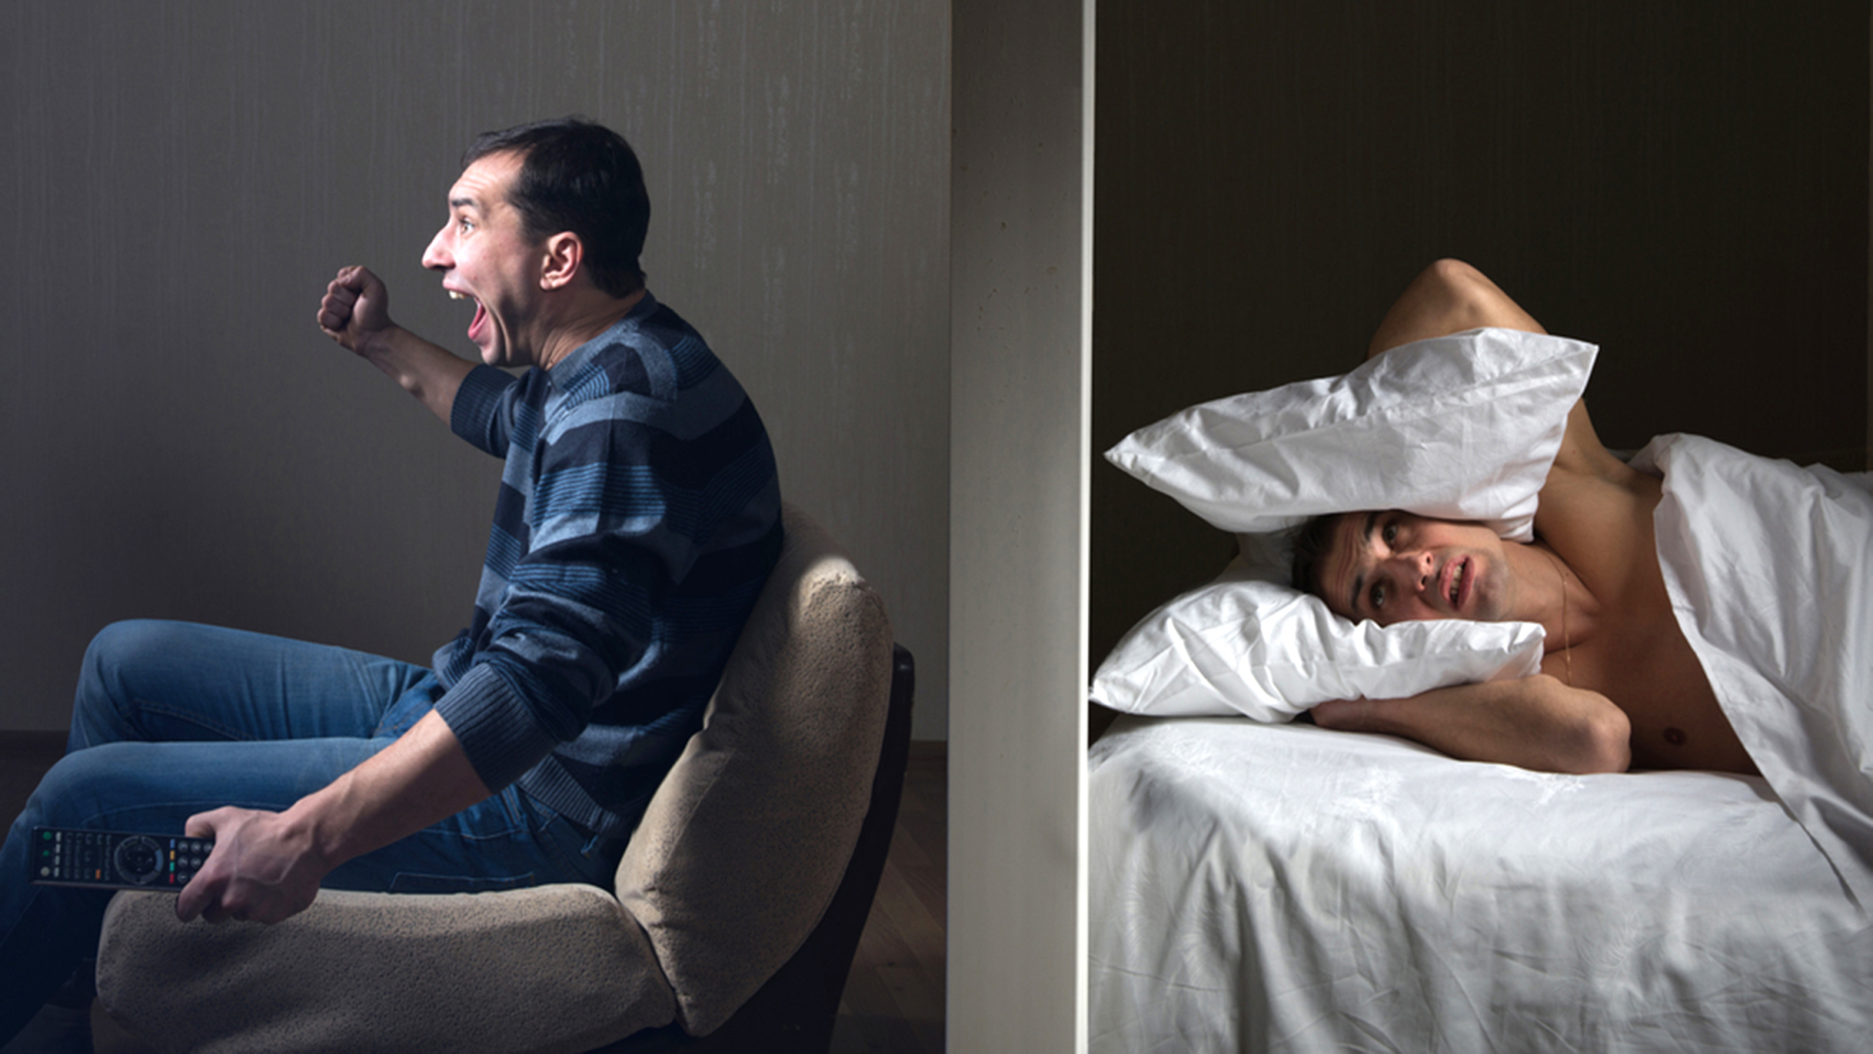
What would you say?

Slide 3
Change the rude phrases to polite phrases
I want to tell you about my neighbour who is very noisy. You must tell him to turn down the volume on his TV. It is very selfish because it keeps me awake all night. Now, I feel tired all the time. Fix it for me. | I would like to talk about… I would be grateful if you could… I would appreciate your help. Unfortunately, it is very frustrating… As a result…

Slide 4
Change the rude phrases to polite phrases
I would like to talk about my neighbour who is very noisy. I would be grateful if you could tell him to turn down the volume on his TV. Unfortunately, it is very frustrating because it keeps me awake all night. As a result, I feel tired all the time. I would appreciate your help. | I would like to talk about… I would be grateful if you could… I would appreciate your help. Unfortunately, it is very frustrating… As a result…

Slide 5
Ascentis L1 S&L Exam Task 2: Role Play
You have decided to speak to your councillor about your neighbour.
First discuss possible solutions with your neighbours and decide what you are both going to do
Explain the problem to the councillor and ask for their help

